Slide 1
INVESTMATE

Slide 2
AGENDA
TEAM MEMBERS
PROJECT OVERVIEW
PERSONAS
TECH STACK
SPRINT SCHEDULE
TEAM AGREEMENT
RETROSPECTIVE
WIKI LINK

Slide 3

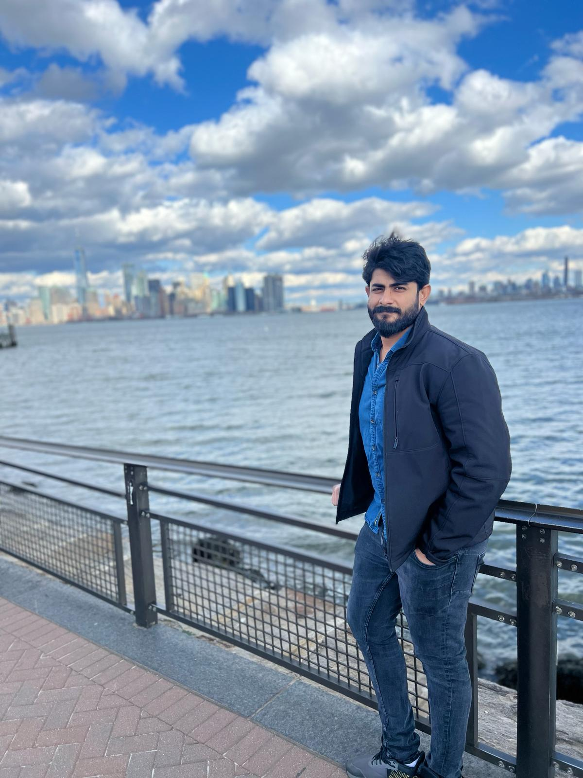

team members
Mani Chandana Kilaru
developer
venkatesh nidumukkala
Scrum master tester
charan raju m
developer

Slide 4
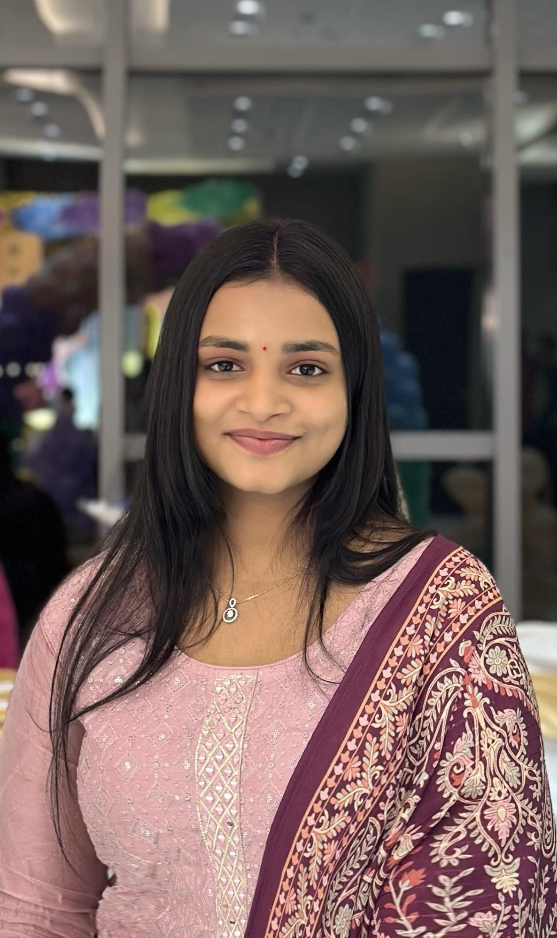
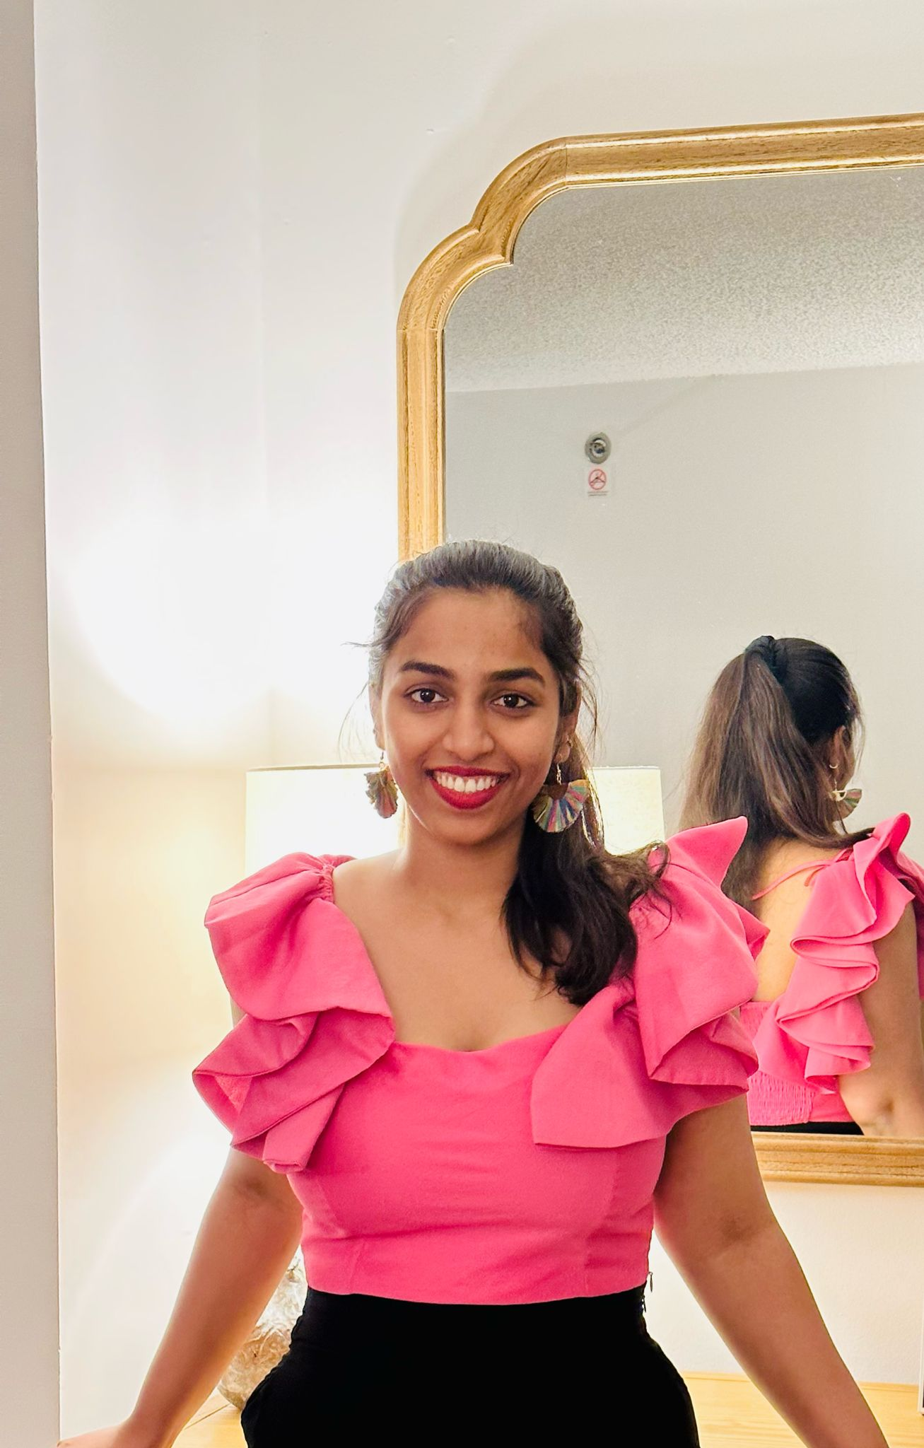
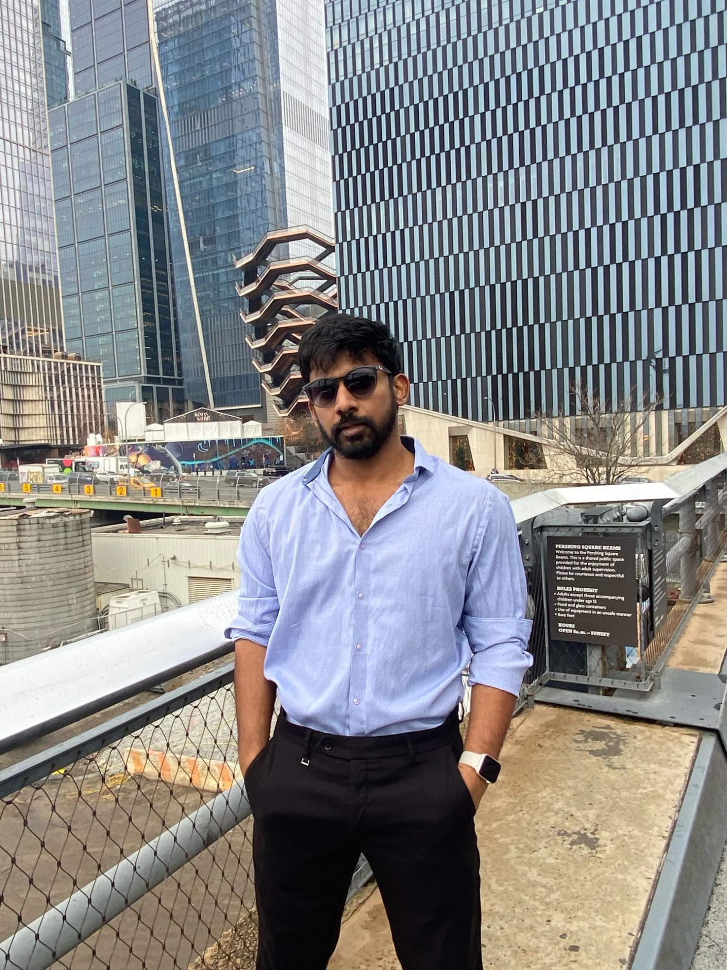
team members
Uma Maheshwari bichinepally
developer
Ankit Mhatre
machine learning engineer
Tejaswi koppula
developer

Slide 5
1.Venkatesh Nidumukkala – scrum master
2.Ankit mhatre - Machine learning engineer
3.Uma Maheshwari Bichinepally - Developer
4.Tejaswi Koppula - Developer
5.Charan Raju M - Developer
6.kilaru Mani Chandana - Developer
TEAM MEMBERS

Slide 6
Changes and improvements done
Adding Images
Removing Market Analysis
Adding Algorithms
Detailed Explanation on Technologies

Slide 7
In a modern world of finance, numerous young people aged from 18 to 25 years old are confused looking at the situation when, on one hand, they aspire to get involved in this global trend but, on the other hand, they experience numerous difficulties trying to search for a source of practical experience and knowledge. Even as you understand the principles from the course rooms academically, you struggle to apply them in the real life scenarios. This results in proficiency gap between your educational knowledge and investment strategies. This gap is a result of overwhelming complications in the structure as well as the FEAR of monetary loss, which is a key factor education platform which should be easy to understand and also a learner-based approach should be discovered.
PROBLEM STATEMENT

Slide 8
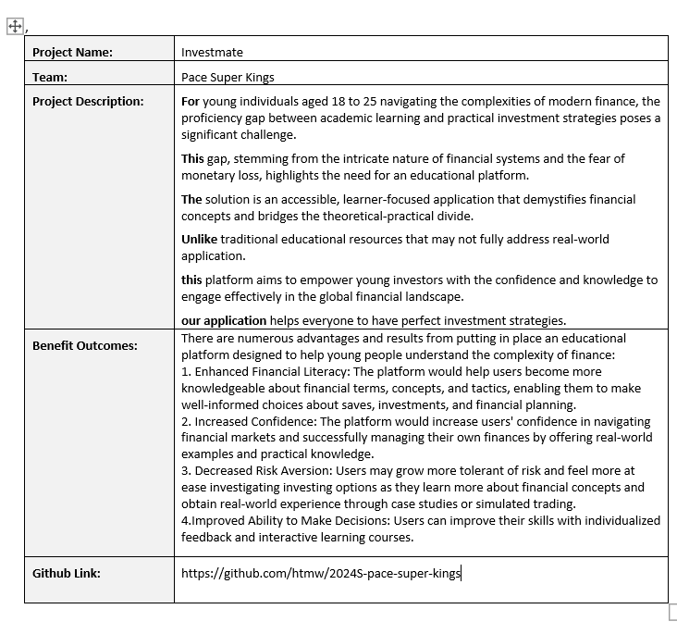
PROJECT DESCRIPTION

Slide 9

PERSONAS -1
Name: Priya
Age: 23
Occupation: College student in the final year, aspiring to start her own business.
Investment Experience: Minimal experience.
Goals: To acquire investment management skills for better financial management.
Challenges: Unable to balance academic responsibilities, entrepreneurial planning and investment learning.

Slide 10

PERSONAS-2
Name: Sara
Age: 20
Occupation: College student majoring in English Literature.
Investment Experience: None.
Goals: Interested in learning about personal finance and investing to start saving for the better future
Challenges: Unable to understand the financial terms

Slide 11
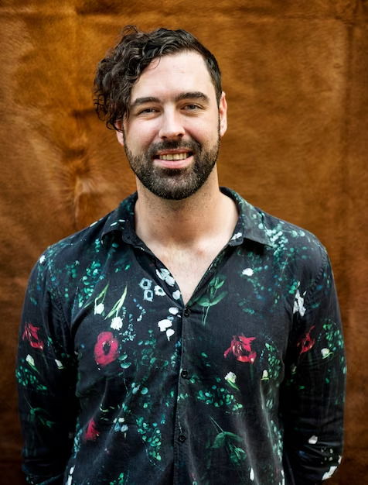
PERSONAS-3
Name: Michael
Age: 25
Occupation: College student majoring in finance.
Investment Experience: No practical experience.
Goals: To gain hands-on experience in the stock market using his classroom knowledge.
Challenges: Finds it difficult to apply his theoretical knowledge in real-world

Slide 12
MVP (Minimum Viable Product )
User Authentication
ML-driven Trading Simulations
Adaptive Risk Management Tools
Personalized Learning Paths

Slide 13


Technologies - Frontend
React Js is used for building frontend application and tailwindcss is used for styling.

Slide 14


Technologies - Backend
Node js is used for backend services and even mongodb is used as an NoSQL database and to store the data.

Slide 15

Technologies - Machine Learning
Sciket Learn is used for Machine learning and to do predictions.

Slide 16


Technologies - Cloud
AWS is used for deploying the application and docker is used for containisation and scalability.

Slide 17
Machine Learning Algorithm
Random Forests predict trends in ML-driven trading simulations.
Logistic regression classifies risks in adaptive management tools.
K-means clustering tailors content in personalized learning paths.

Slide 18
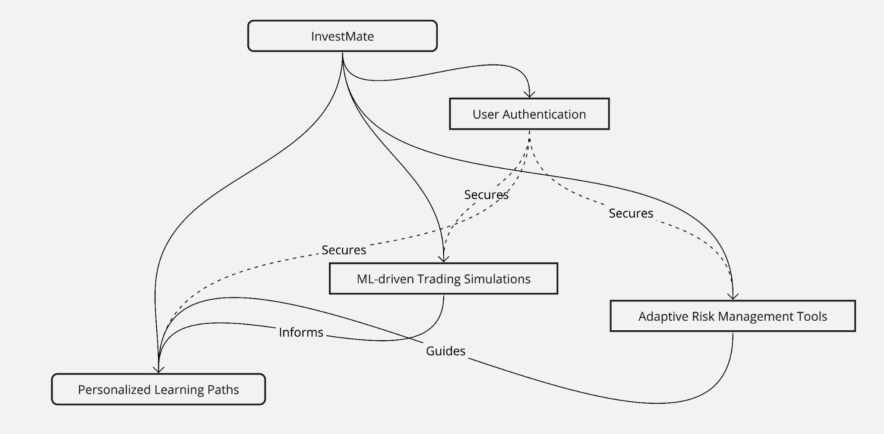
Conceptual Diagram

Slide 19
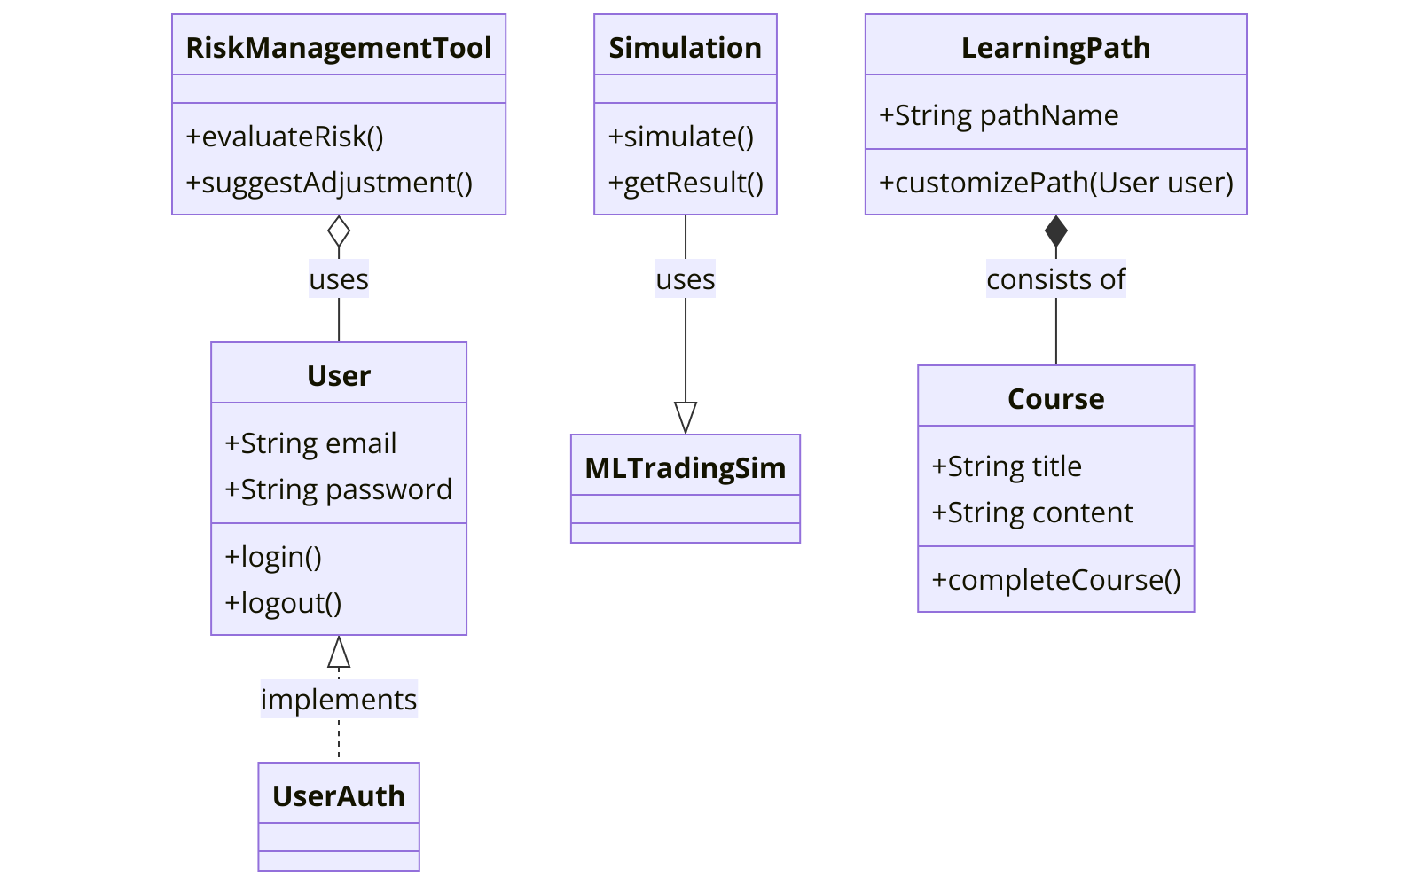
Class Diagram

Slide 20
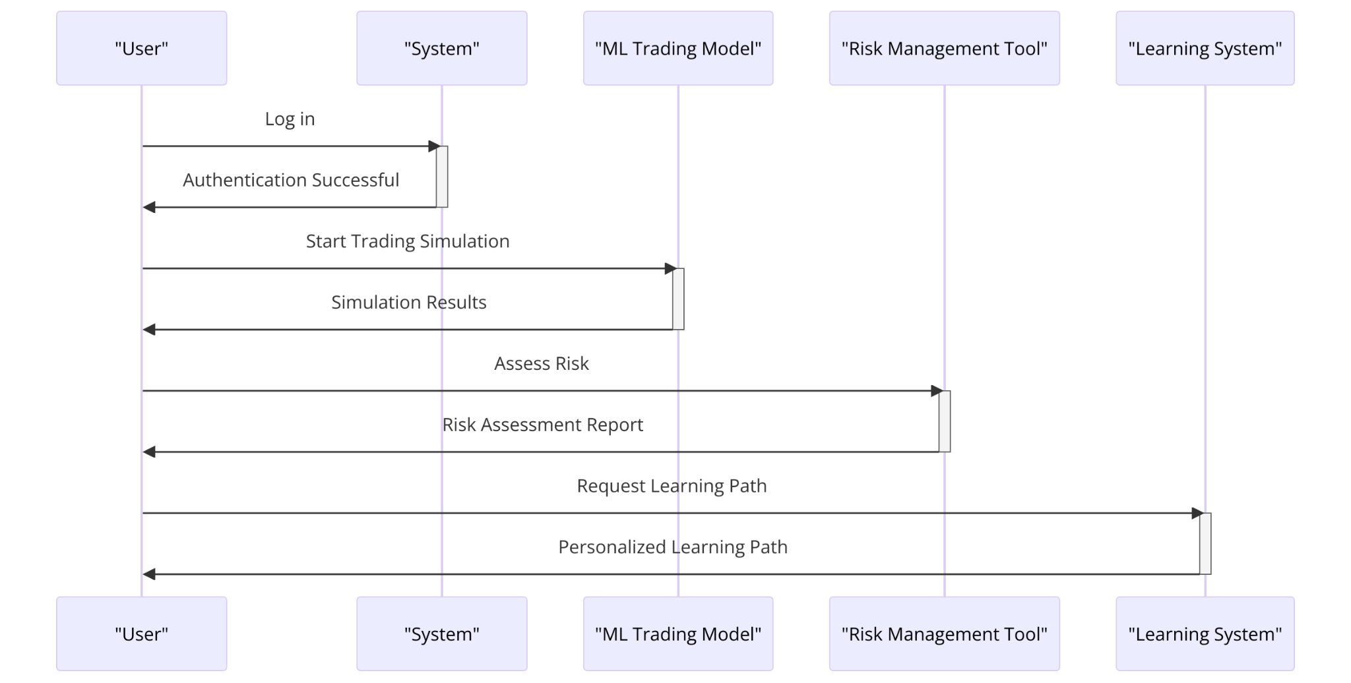
Sequence Diagram

Slide 21
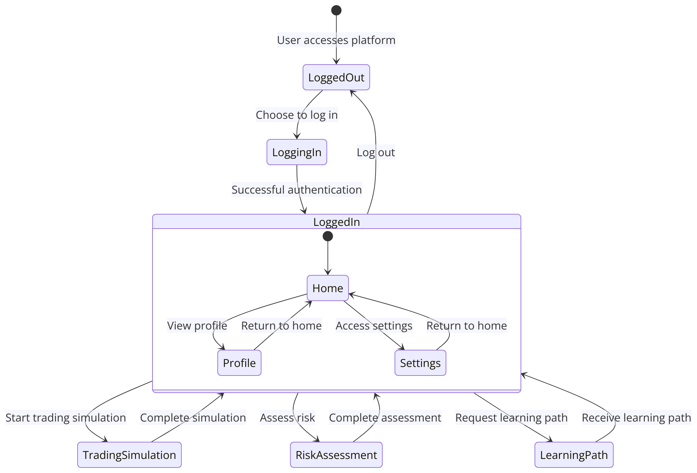
State Diagram

Slide 22
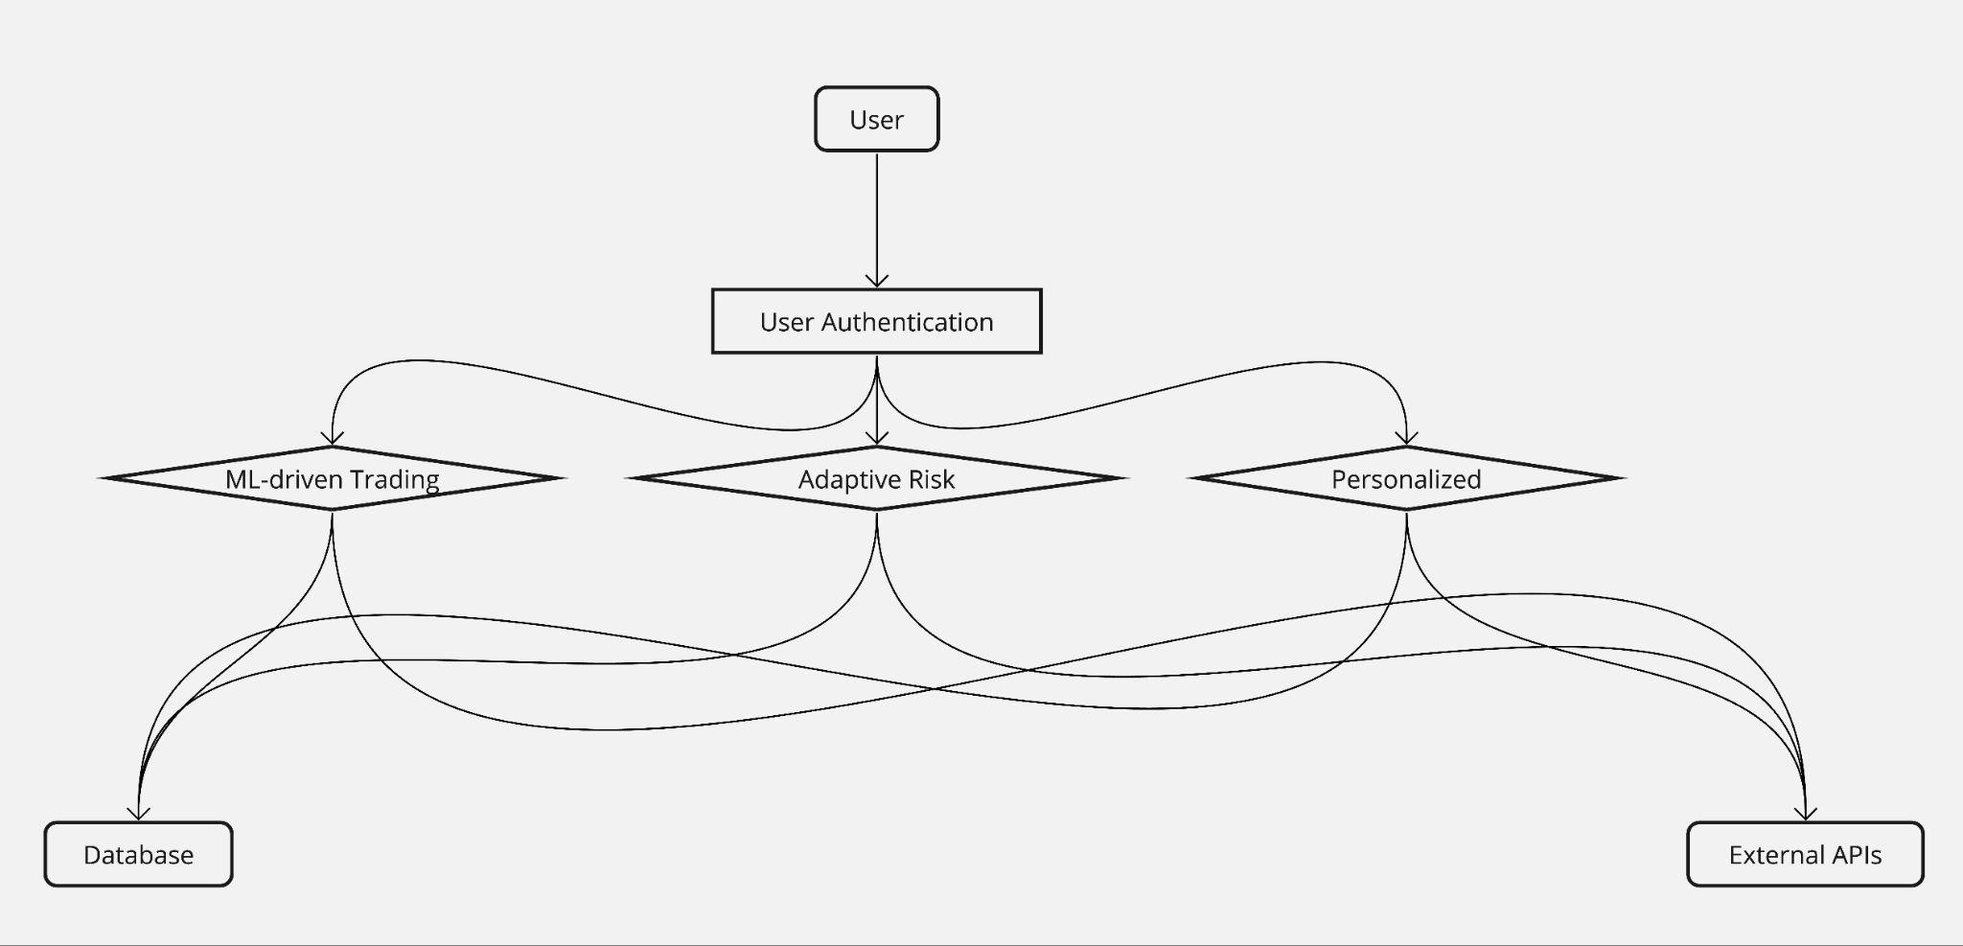
Context Diagram

Slide 23
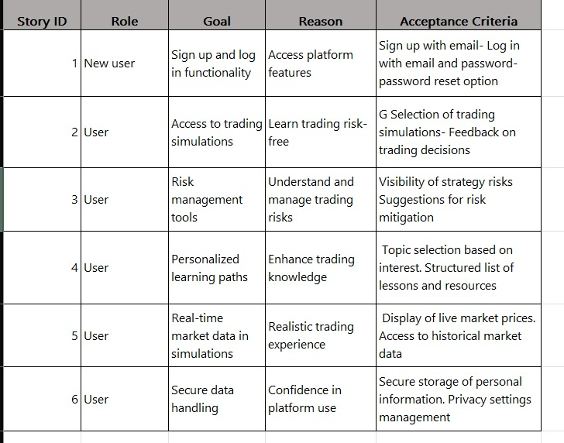
USER STORIES/Acceptance Criteria

Slide 24
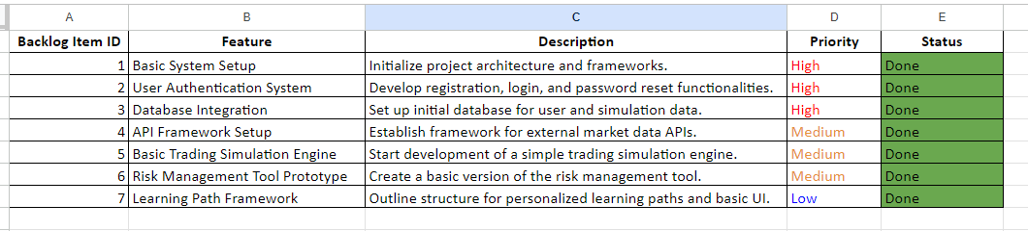
Sprint Backlog

Slide 25
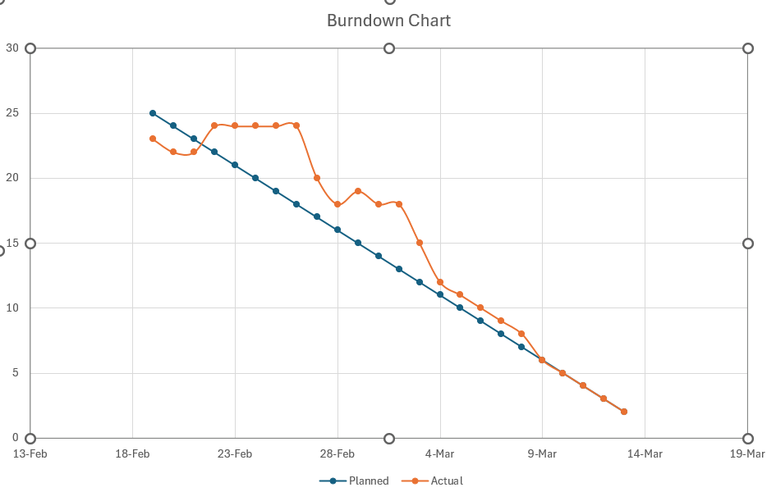
Burndown chart

Slide 26
team velocity
25 story points

Slide 27
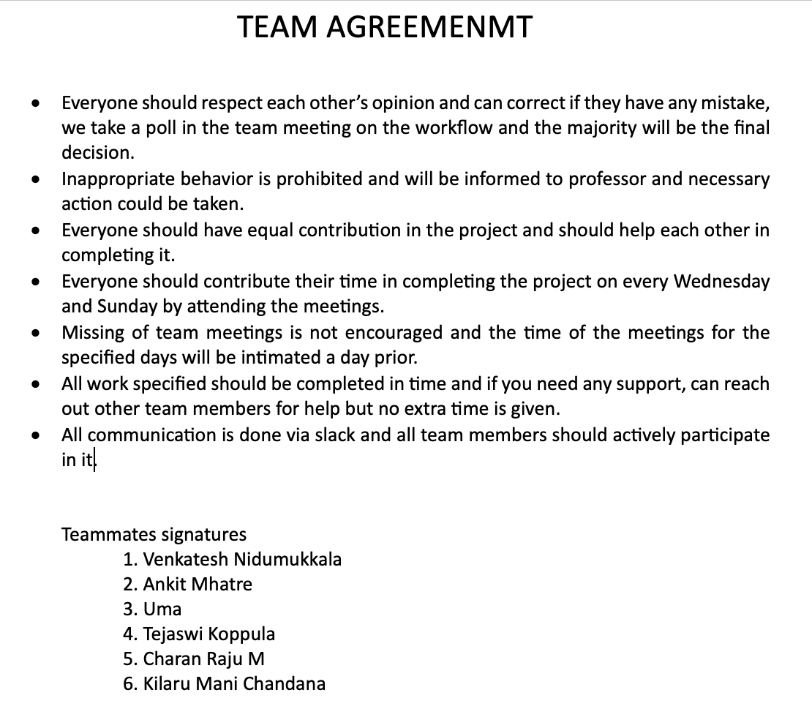
TEAM AGREEMENT

Slide 28
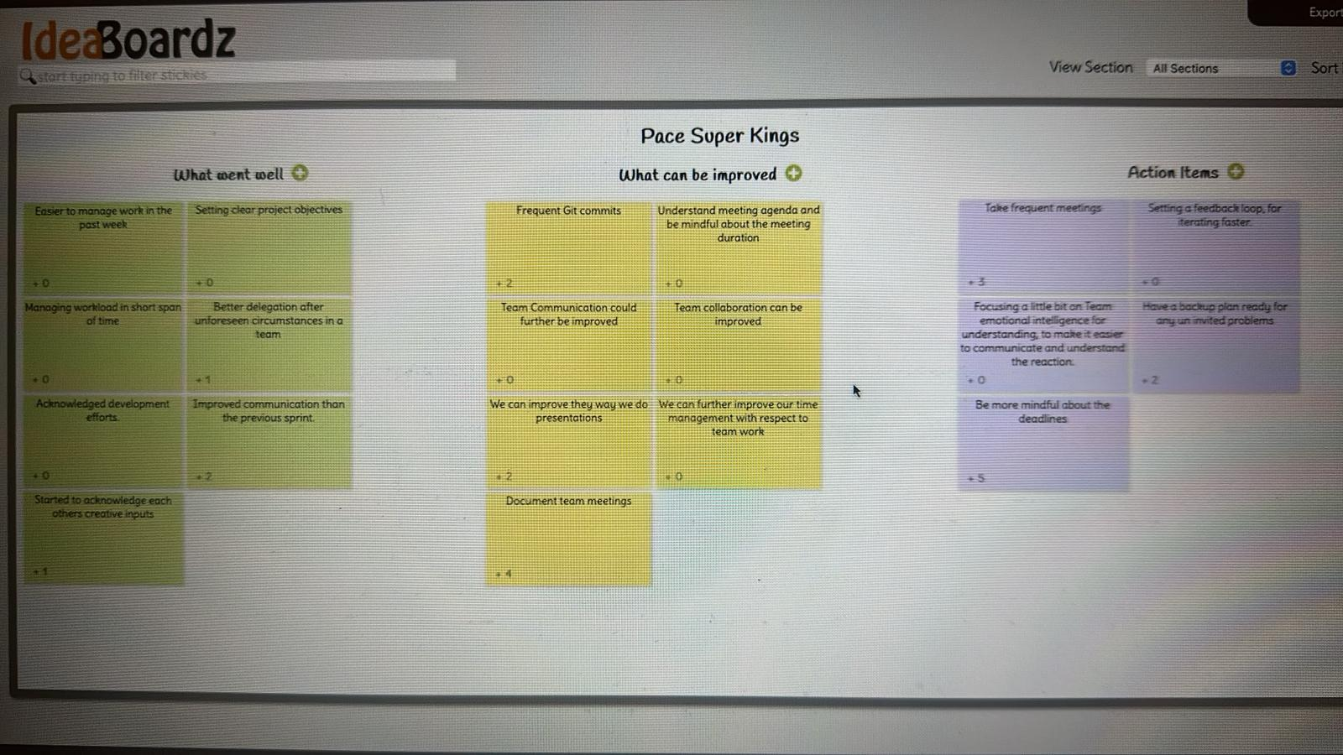
RETROSPECTIVE

Slide 29
Sprint 3 updates
Connect the API with frontend
Make proper connections between backend and frontend.

Slide 30
WIKI LINK
https://github.com/htmw/2024S-pace-super-kings/wiki

Slide 31
API Updates
basic connection between nodejs and Mongo Db has been executed currently.
it is able to connect to the database and all current operations are successful.
Able to bring Live stock market data

Slide 32
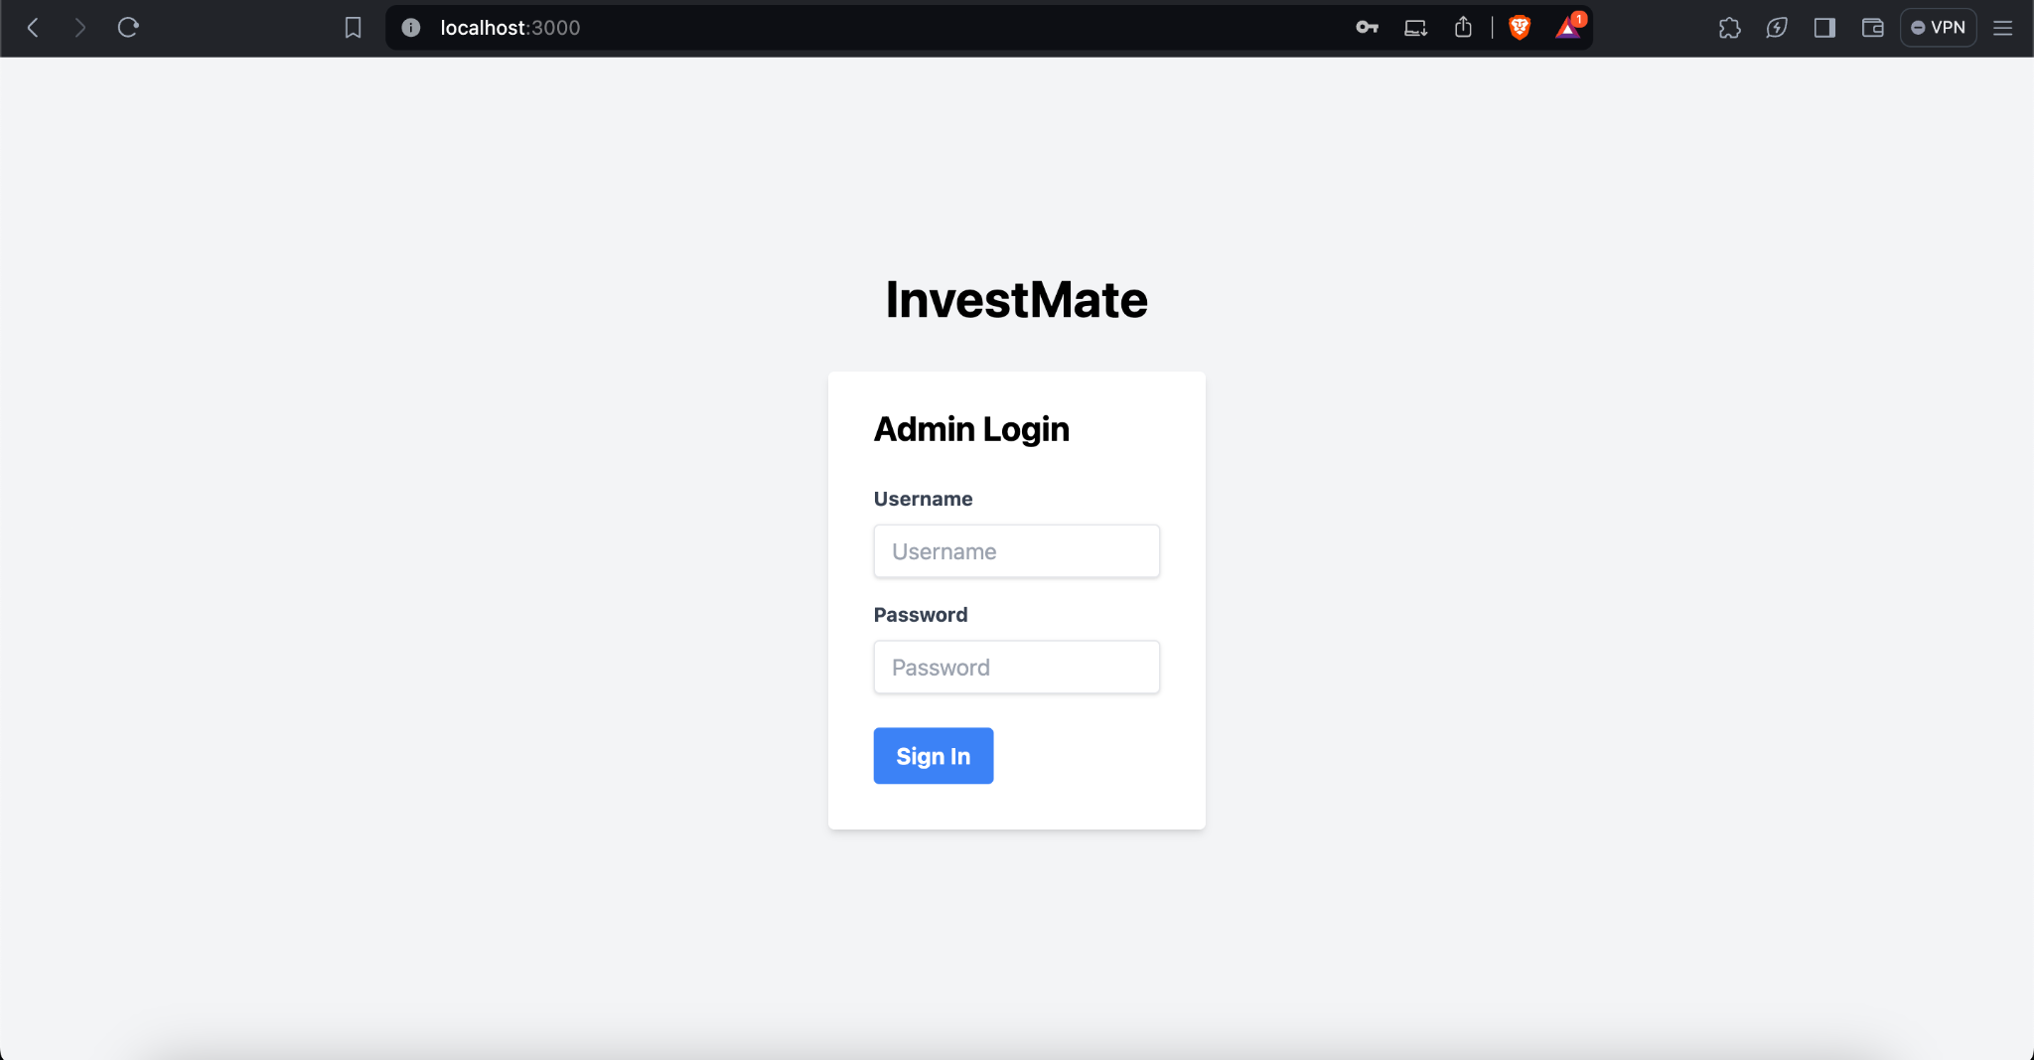
Demo ScreenShots

Slide 33
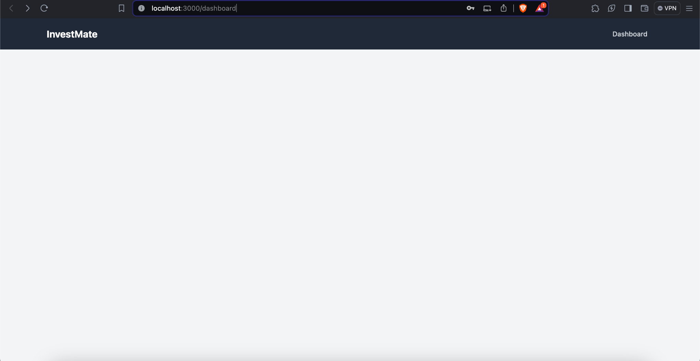
Demo ScreenShots

Slide 34

THANK YOU

